Slide 1


JAVA Java Interview boot camp Core concepts
Lecture 20
CHAPTER 22-Part 1
Collections

Slide 2
COLLECTIONS
(An easy way to manage Objects)

Slide 3

What Is A Collection ?
As the name indicates,a collection is a group of objects known as its elements. Examples of collections are :
Set of Books
List Of Names
List of phone numbers
Records Of Students
List Of e-mail id. etc

Slide 4
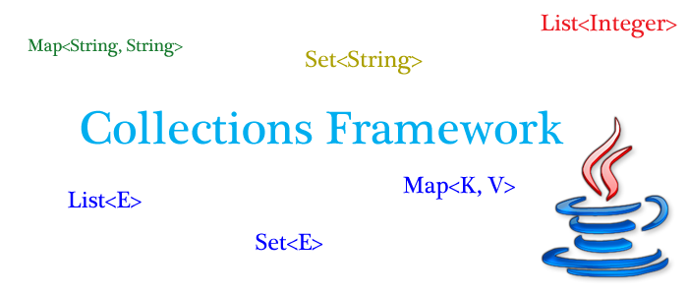
How Java supports Collections ?
To handle such collection of objects, Java offers us a huge set of predefined classes and interfaces called as
“The Collections Framework”
which is available in the package “java.util”

Slide 5
Why do we need to learn Collection ?
The first question which comes in mind of every programmer is
Why should I use Collection classes when I have an array ?
Answer:
Although arrays are very useful data storage structures but they suffer from several important drawbacks which are:
1.Remains of fixed size
2.Contains only homogeneous elements
3.No facility to add or remove elements in between

Slide 6
Advantages Of Collections
Can dynamically grow or shrink
Can contain heterogeneous or homogeneous elements
Provide predefined methods to perform all C R U D operations

Slide 7
Types Of Collections
There are 3 main types of collections:
Lists: always ordered, may contain duplicates and can be handled the same way as usual arrays
Sets: cannot contain duplicates and provide random access to their elements
Maps: connect unique keys with values, provide random access to its keys

Slide 8
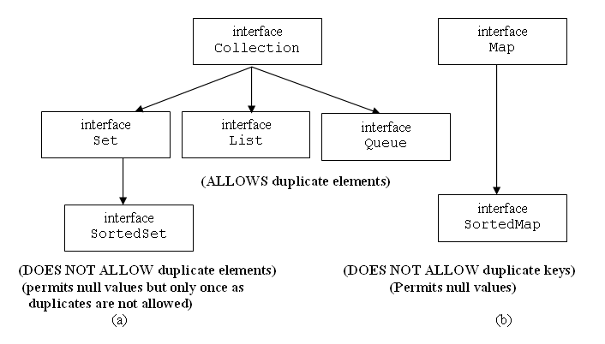
The Collection Hierarchy

Slide 9
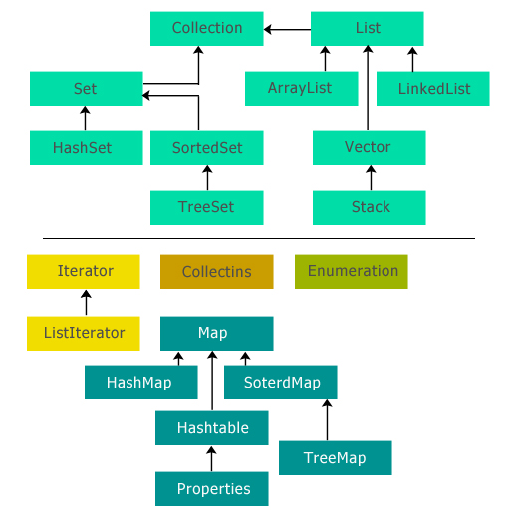
The Collection Hierarchy

Slide 10
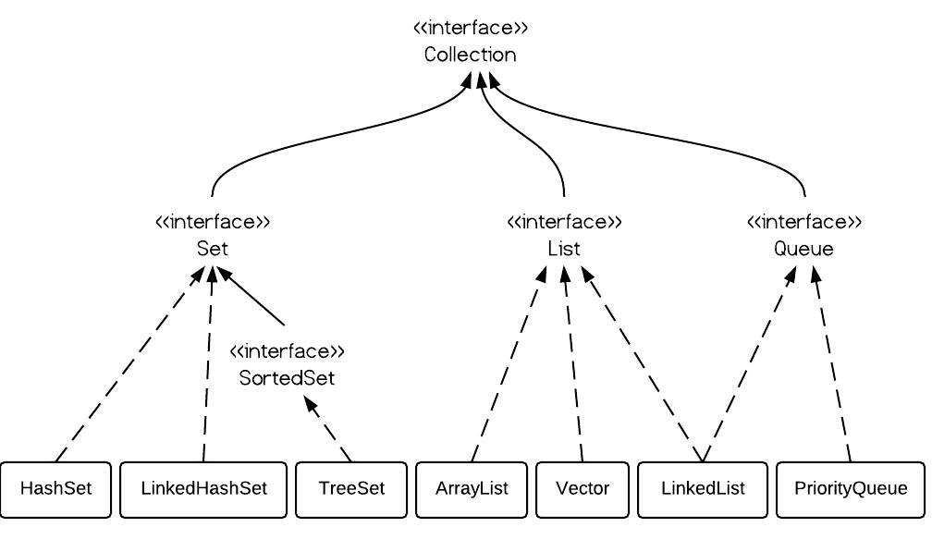
The Collection Classes

Slide 11
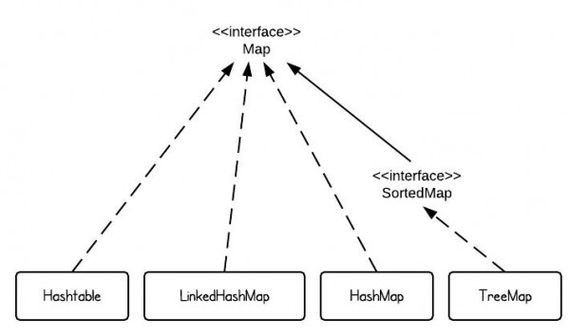
The Map Classes

Slide 12
Quiz
The core collection interfaces are organized into two distinct inheritance trees. One interface in particular is not considered to be a true Collection, and therefore sits at the top of its own tree. What is the name of this interface?
Answer: Map

Slide 13
Quiz
What interface represents a collection that does not allow duplicate elements?
Answer: Set
What interface forms the root of the collections hierarchy?
Answer: Collection

Slide 14
Quiz
What interface represents an ordered collection that may contain duplicate elements?
Answer: List
What interface represents a collection that holds elements prior to processing?
Answer: Queue

Slide 15
Quiz
How many different ways are there to iterate over the elements of a Collection.
Answer: 5
How many cursors are there to iterate over the elements of a Collection.
Answer: 3

Slide 16
Quiz
Name these cursors
Answer: Iterator, Enumeration and ListIterator
Which interface in Collections extends RandomAccess ?
Answer: None ! , It is extended by ArrayList and Vector classes

Slide 17
Quiz
What is the difference between Collection and Collections ?
Answer: First is an interface while second is a class
Which classes in Collections hierarchy are thread-safe ?
Answer: Vector,Stack,Hashtable,Properties and PriorityBlockingQueue

Slide 18
Quiz
Arrange the following in the ascending order (performance): HashMap , Hashtable , HashSet ?
Answer: Hashtable<HashMap<HashSet
Does HashSet allow null ?
Answer: Yes, but only once!

Slide 19
Quiz
Difference between HashMap and Hashtable
Answer:
HashMap | Hashtable
Not Synchronized | Synchronized
Allows null | Doesn’t allow null
Useful for Single threaded environment | Useful for multithreaded environment
Used very much | Declared as Legacy class

Slide 20
Quiz
Difference between ArrayList and LinkedList
Answer:
ArrayList | LinkedList
Backed by growable Array | Backed by Doubly Linked List
Allows random access using get() method | Does give a get() method but internally traverses from head to tail
Faster in retrieval but slower in addition and deletion | Slower in retrieval but faster in addition and deletion
Uses less memory | Uses more memory as it also maintains references to previous and next nodes

Slide 21
Quiz
Difference between HashSet and TreeSet
Answer:
HashSet | TreeSet
Maintains elements in random order | Maintains elements in sorted order
Allows null | Doesn’t allows null
Backed by HashMap | Backed by binary tree
Faster | Slower
Less functionality | Rich in functionality

Slide 22
Quiz
Which collection would you use if you needed to maintain and search on a list of parts identified by their unique alphanumeric serial number
Answer: Map

Slide 23
Quiz
18 Which collection class(es) allows you to shrink its size and provides indexed access to its elements, but whose methods are not synchronized? (Choose all that apply.)
A. java.util.HashSet
B. java.util.LinkedHashSet
C. java.util.List
D. java.util.ArrayList
E. java.util.Vector
F. java.util.PriorityQueue
Answer: D

Slide 24
Important Methods Of Collections
The Collection interface is one of the root interfaces of the Java collection classes. The general methods list of the collection interface is:
boolean add(Object obj)
void clear( )
boolean contains(Object obj)
boolean equals(Object obj)
int hashCode( )
boolean isEmpty( )
Iterator iterator( )
boolean remove(Object obj)
boolean removeAll(Collection c)
boolean retainAll(Collection c)
int size( )
Object[ ] toArray( )

Slide 25
The List Interface
The java.util.List interface is a subtype of the java.util.Collection interface and represents an ordered collection (sometimes called a sequence).
It means we can access the elements of a List in a specific order, and by an index too.
It allows duplicate objects and one or more elements to be null.
The user of this interface has precise control over where in the list each element is inserted and can access elements by their integer index (position in the list), and search for elements in the list.

Slide 26
The List Interface
The java.util.List interface is a subtype of the java.util.Collection interface and represents an ordered collection (sometimes called a sequence).
It means we can access the elements of a List in a specific order, and by an index too.
It allows duplicate objects and one or more elements to be null.
The user of this interface has precise control over where in the list each element is inserted and can access elements by their integer index (position in the list), and search for elements in the list.

Slide 27
Implementation Classes Of “List”
We can choose between the following List implementations in the Java Collections API: java.util.ArrayList java.util.LinkedList java.util.Vector java.util.Stack Here are a few examples of how to create a List instance: List listA = new ArrayList(); List listB = new LinkedList(); List listC = new Vector(); List listD = new Stack();

Slide 28
The “ArrayList” class
ArrayList implements List interface.
ArrayList capacity grows automatically.
The ArrayList is not synchronized.
It permits all elements including null.
Array lists are created with an initial size of 10
When this size is exceeded, the collection is automatically enlarged and when objects are removed, the array may be shrunk.

Slide 29
Constructors Of ArrayList
public ArrayList( )
This constructor builds an empty array list with an initial capacity of 10
public ArrayList(int capacity)
This constructor constructs an empty list with the
specified initial capacity.
public ArrayList(Collection c)
Constructs a list containing the elements of the specified
collection, in the order they are returned by the collection's
iterator.

Slide 30
Example
ArrayList fruits=new ArrayList();
fruits.add("Mango");
fruits.add("Apple");
fruits.add("Guava");
System.out.println("Contents are:"+fruits);
Output:
Contents are:[Mango, Apple, Guava]

Slide 31
Question 1
Write a program to accept 5 unique integers from the user and store them in the list if they are already not present.

Slide 32
Question 2
Write a program to accept 10 integers from the user and display how many were unique and how many were duplicate. Also display these numbers

Slide 33
Converting Array To ArrayList
We can convert an array to arraylist using following ways.
Arrays.asList() method - Pass the required array to this method and get a List object and pass it as a parameter to the constructor of the ArrayList class.
Collections.addAll() method - Create a new list before using this method and then add array elements using this method to existing list.
Iteration method - Create a new list. Iterate the array and add each element to the list.

Slide 34
Arrays.asList()
Prototype: public static List asList(T... a)
Returns a fixed-size list backed by the specified array.
The returned list is serializable and implements RandomAccess.
Since returned List is fixed-size therefore we can’t add more element in it, but we can replace existing element with new element using set(index, new Element) method defined in ArrayList class.

Slide 35
Example
String[] days={"Mon","Tue","Wed"};
List<String> daysList=Arrays.asList(days);
System.out.println(daysList);

Slide 36
Adding New Element
String[] days={"Mon","Tue","Wed"};
List<String> daysList=Arrays.asList(days);
System.out.println(daysList);
Output:
[Mon, Tue, Wed]
Exception in thread "main" java.lang.UnsupportedOperationException
Conclusion:
Since returned List is fixed-size List, we can’t add more element(s). An attempt of adding more elements would cause UnsupportedOperationException.

Slide 37
Solution
String[] days={"Mon","Tue","Wed"};
List<String>daysList=new ArrayList(Arrays.asList(days));
System.out.println(daysList);
daysList.add("Thu");
System.out.println(daysList);
Output:
[Mon, Tue, Wed]
[Mon, Tue, Wed, Thu]

Slide 38
Collections.addAll()
Prototype: public static boolean addAll(Collection c, T... a)
Adds all of the specified elements to the specified collection.
Elements to be added may be specified individually or as an array.

Slide 39
Example
String[] days={"Mon","Tue","Wed"};
ArrayList<String> daysList=new ArrayList<>();
Collections.addAll(daysList, days);
System.out.println(daysList);
daysList.add("Thu");
System.out.println(daysList);
Output:
[Mon, Tue, Wed]
[Mon, Tue, Wed, Thu]

